Slide 1


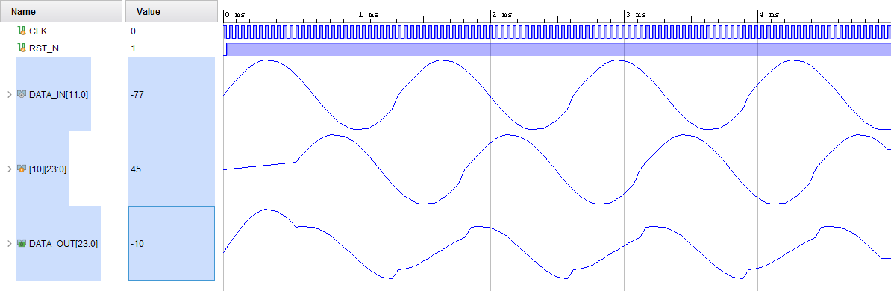
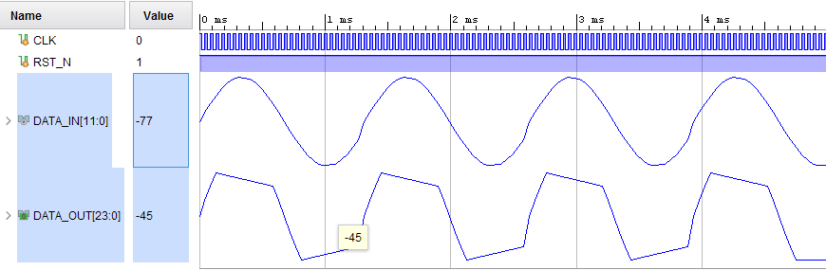
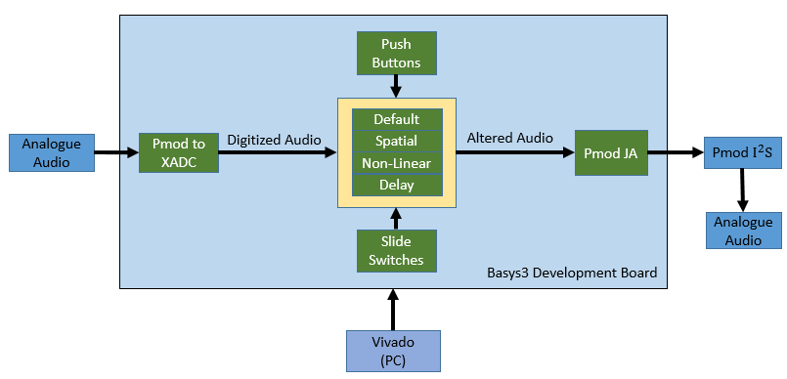
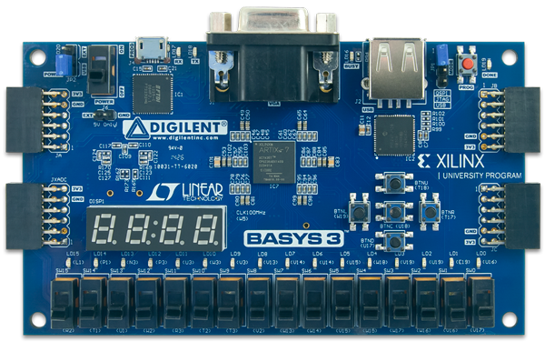
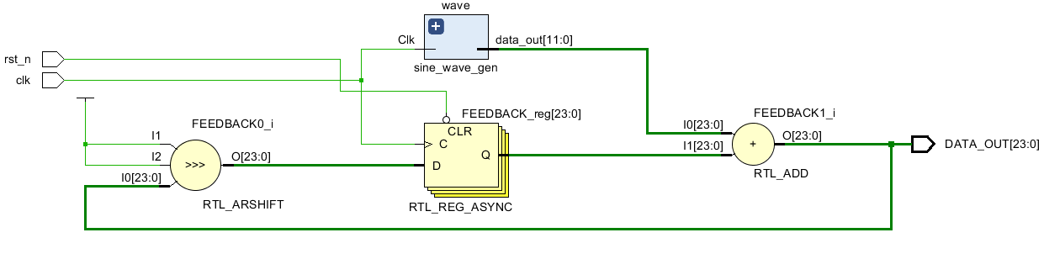
Dept. of Electrical & Electronic Engineering, CIT
FPGA Based Audio Effect System
Dean Devereaux
Photo
Individual or team photo
Introduction
The objective for this project was to program a field programmable gate array(FPGA) to take in analogue audio and convert it to a digital form were an effect would be applied through the use of digital filters. This audio would then be output and converted back into an analogue signal were the effect can be observed. The Artix-7 FPGA chip was used for this project which had a Basys3 development board. Pmod i2s was to be used for digital to analogue conversion.
The three effects aimed to be used with the FPGA are delay, reverb, overdrive and distortion. The reasoning for using a FPGA is due to how expensive it is to obtain an FX system for hardware and software. The low cost and advanced functionality of the chip along with the ability to be reconfigured gives the FPGA an opportunity to improve FX systems within the music and film industry. This interface technology has already been achieved by hardware company Antelope Audio.
5. Results
FIR vivado test can be seen below in fig. 4. These are simulation results and show the input sine wave, the delayed feedforward signal and the resulting output. This implementation was also tested on MATLAB with an audio file to hear how it would sound. The overdrive results in fig. 5. show the sine wave signal with the corresponding saturated output value. In MATLAB this result looks much sharper and the effect can be heard.
Design
Below in fig. 2. the block diagram can be seen which represents the layout envisioned for the project. Analog audio will be input into the Pmod which interfaces with the XADC. The digitized audio will then have an effect applied based on the logic of the slide switches. The push buttons are used to increment or decrement the gain used for specific effects. If no effect is chosen with the slide switches then the signal goes through a default state and sends the audio to the Pmod JA with no altercations. The I2S DAC will interface with Pmod JA and convert the signal back to analogue.
Fig. 4. FIR Response
Fig. 5. Overdrive Response
Further Work
If more time was available to work on the project then the hardware problems could be worked on in order to implement the effects as envisioned.
The basys3 board has 15 slide switches, a future development for the project would be to investigate how many effects can be implemented onto the basys3 and which effects would give the least amount of power along with finding out how many effects can be used simultaneously.
The 7 segment displays on the development board could be programmed to display the current chord/note being played. Similarly the LED’s could be used based on the frequency amplitude.
2. Background
The Basys3 development board seen in fig. 1. uses the Artix-7 FPGA. The Artix-7 has an internal ADC capable of sampling at 1MS/s and converting 12 bits. The ADC interfaces with the FPGA through a Dynamic Reconfiguration Port and uses the JXADC Pmod for inputting signals. The Pmod I2S stands for integrated interchip sound and uses GPIO interface. The Pmod I2S is capable of sampling 192kHz and converting up to 24 bits.
Three types of comb filters were used, infinite impulse response(IIR), finite impulse response(FIR) and Universal(UCF) which is a combination of both IIR and FIR. IIR simulates endless reflections with a delayed feedback while using a gain to attenuate the signal. FIR only simulates a single delay with feedforward of the input.
Combination of IIR filters and UCF creates a reverberator. The IIR are in parallel and UFC in series set up as an all-pass filter which is done by having the feedback gain as the negative value of the feedforward gain. The IIR filters must all have different delay values close together in order to give a natural sound of reverb. The all-pass filters will then increase reflection density of the signal.
Overdrive and distortion are both non-Linear processing techniques. Distortion is controlled by a gain value and then the distorted signal is mixed with original signal to give the effect. Overdrive uses symmetrical soft clipping which adds odd harmonics to the signal and gives saturation
Fig. 2. Block Diagram Design
4. Implementation
Vivado design suite was used to implement the filters onto the development board. The board was programmed using Verilog HDL
IIR and FIR were programmed for a delay. IIR involves feedback and simulates endless reflections of the signal while FIR simulates a single delay due to feedforward of the input. A shift register had to be used in order to save the signal and delay. An arithmetic shift right of bits was used to apply a gain of ½, ¼ or 1/8.
Overdrive was implemented on the board by using symmetrical soft clipping which would cause saturation. This was done by programming a threshold value.
7. Conclusions
Although an audio effect system was not implemented on the actual hardware the FIR comb filter and overdrive were simulated on it and the implementation was also tested on MATLAB. The Artix-7 FPGA does have the capability to be used as an audio effect system in theory and simulation. How much is it capable of is the next question.
Delay Type | Time
Resonator | 0-20ms
Slap back | 25-50ms
Echo | >50ms
Acknowledgements
I would like to thank my supervisor Paddy Collins and assessor Dr. John Horan for their advice and support through the year
Fig.1. Basys3 Development Board
Fig.3. IIR Filter RTL Schematic
Publications
Rojas, J., Zhelev, T., & Bojarski, A. D. (2010a) 'Modelling and Sensitivity Analysis of ATAD', Computers and Chemical Engineering, vol. 34, issue 5, pp. 802-811.
Rojas, J., Burke, M., Chapwanya, M., Doherty, K., Hewitt, I., Korobeinikov, A., McCarthy, S ., Meere, M., Tuoi, V., O’Brien, M., Winstanley, H., Zhelev. T. (2010b) 'Modeling of Autothermal Thermophilic Aerobic Digestion' Mathematics-in-Industry Case Studies (MICS) Journal, vol. 2, pp. 34-63.
N. Vaklieva- Bancheva, E. Kirilova, T. Zhelev and J. Rojas, (2010). ‘Modeling of Energy Integrated ATAD System’, Journal of International Scientific Publications: Materials, Methods & Technology, vol. 4, issue 1, pp. 220-233.
Rojas, J., Zhelev, T. ‘Energy Efficiency Optimisation of Wastewater Treatment: Study of ATAD’ (in preparation)
Capon-Garcia, E., Rojas, L., Zhelev, T., Graells, M., ‘Operation Scheduling of Batch Autothermal Thermophilic Aerobic Digestion Processes’ (in preparation)

